Slide 1
EY Techathon 5.0 Detailed Submission
Date of submission:

Slide 2
Congratulations on making to the next round. As we move towards the next stage, we would like you to note a few key points
Evaluation parameters
We are inviting a detailed solution submission for the next round. The ppt document that you submit should cover the below :
Team Details (refer slide 3 – pictures should be high resolution; Size: 1200X1800 | 2MB; Front facing camera; Attire: Formal | Presentable | No accessories like sunglasses etc | Plain background)
Executive Summary (refer slide 4)
Problem statement and Solution proposed (refer slide 5)
Approach and methodology (refer slide 6)
Details to be submitted separately (refer slide 7)
Working prototype/output (refer slide 8 - this is key to your presentation and you/ your team will be expected to screen share and demonstrate the same if you make it to semi-finale round) (kindly record and share the video file of the prototype demonstration (as a backup file))
Scope of the problem covered in the solution
Solution design and use of technology
Uniqueness of Solution and Innovation
End-user benefit and impact
Please upload your submissions on the Unstop website (PPT in .pptx, Video files in .mp4 formats only)
Submission link will be live on 07 November 2023. Last date for submissions is 26 November 2023.

Slide 3
Tell us about yourself | Highlight a technical skill or skills each member brings to the team
Team Name: XX
Problem Statement : XX
Team Member 1 pic
Team Member 2 pic
Team Member 3 pic
Team Member 4 pic
Team Member 5 pic
Team Member 1 Name : XX
College name : XX
Contact Detail (phone number) : XX
Role in Solution Development (please specify) : XX
Team Member 2 Name : XX
College name : XX
Contact Detail (phone number) : XX
Role in Solution Development (please specify) : XX
Team Member 3 Name : XX
College name : XX
Contact Detail (phone number) : XX
Role in Solution Development (please specify) : XX
Team Member 4 Name : XX
College name : XX
Contact Detail (phone number) : XX
Role in Solution Development (please specify) : XX
Team Member 5 Name : XX
College name : XX
Contact Detail (phone number) : XX
Role in Solution Development (please specify) : XX

Slide 4
Executive Summary (minimum 200 words)

Slide 5
Problem statement - Your understanding
Define the exact problem that you intend to solve and your understanding of the same. Share the below details:
Target Industry: <<Industry Name>>
Industry Type: <<B2B/B2C>>
User Group: <<User Group Name>>
User Department: <<Department Name>>
Solution Scenario: <<Solution Scenario describing the user flow in the proposed solution>>
Proposed Data Flow: <<Describing how the Data will be captured and flow between events>>

Slide 6
Explain, in brief, how you intend to solve the problem at hand. Preferably include the following (Methodology/approach):
Please elaborate on the solution value proposition to the target user group. How will your solution cover the problem areas?
Response: <<>>
What are the impact metrics that you propose to use to analyse the effect of the solution?
Response: <<>>
What are the technologies (languages, platforms, APIs, hardware, sponsored tools, technologies stacks, framework etc.) involved?
Response: <<>>
Please state the assumptions, constraints and solution decision points (Reason behind choosing a technology)
Response: <<>>
How easily can your solution be implemented and how effective will it be?
Response: <<>>
How robust / secure / easily scalable and extensible is the solution?
Response: <<>>
What are the solution components that you would like to build and demonstrate; if you progress through next round.
Response: <<>>

Slide 7
Attach and submit the below as separate files
Architecture diagram (mandatory)
Flow chart (mandatory)
Wireframes (mandatory)
Graphical representation (bar graph, histogram, pie charts, heat maps) (optional)
Analysis, visualization (optional)
Code Repository (optional)

Slide 8
[Attach Video, link for demo] or [output/visualizations from the prototype]
Working prototype/output – please add Screenshot or video clip of your prototype here

Slide 9
EY Techathon 5.0
Overview and journey so far..

Slide 10

EY Techathon
Annual flagship campus event; running in its fifth consecutive year.
A platform for young minds to leverage technology to address modern day community/business challenges.
An opportunity to gain insights and mentorship directly from EY leaders.
season
season
season
season
1.0
2.0
3.0
4.0
focused on
focused on
focused on
focused on
Vaccine monitoring
(for Covid 19)
Sustainability
Metaverse
Gen AI to reimagine possibilities
Registrations
1,562
1,016
5,050
1,25,000
Techathon is not just a competition; it's a journey of innovation and collaboration
With Techathon 5.0, participants will tackle community and business issues for the greater good, making a real impact. We are calling students to harness the power of AI to address real-world challenges and drive Bharat’s progress.
EY Techathon 5.0
Harnessing AI to
transform Bharat

Slide 11



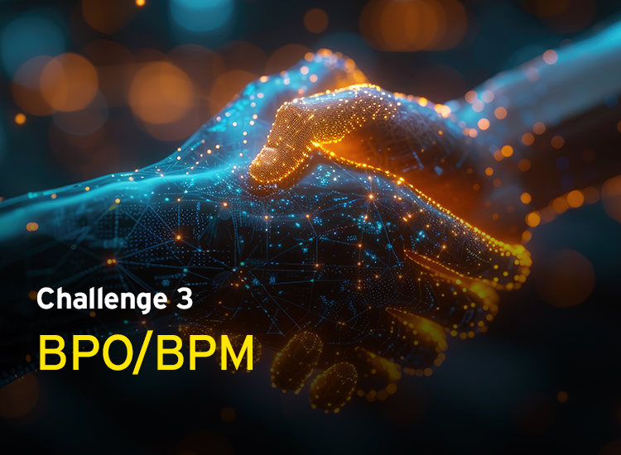
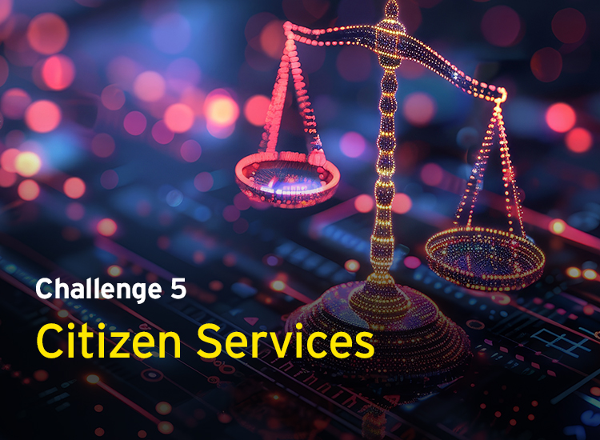

Problem Statements
In a world dominated by Gen AI, Techathon 5.0 aims to unlock the versatility and potential of this technology across 5 crucial sectors

Slide 12




Education
AI for skill development in youth

Slide 13
Education - AI for skill development in youth
Scenario:
Vivek, a student from a small town in West Bengal, has completed his basic education but feels unprepared for the rapidly changing job market. He is aware that he needs to acquire new skills to become employable but is unsure of which skills to focus on or how to begin. With limited access to career guidance, Vivek struggles to identify the right courses that align with his aspirations and the skills currently in demand.
Student’s challenge:
Design an AI-powered platform that helps students like Vivek bridge the gap between their current skills and career aspirations. The platform should assess a student’s existing skills, identify areas for improvement and recommend personalized learning paths. It should provide tailored course suggestions based on individual goals and career trends, while offering periodic assessments to track progress. Instead of offering generic courses, the platform should provide specific interventions and nudges, such as actionable feedback and targeted skill-building activities, ensuring that students receive the right guidance to meet their career objectives and improve their employability.

Slide 14

Healthcare
Empowering traveling doctors with AI

Slide 15
Healthcare - Empowering traveling doctors with AI
Scenario:
Ravi is a traveling doctor who provides healthcare services to multiple rural communities across Jharkhand. With limited time and resources, he finds it challenging to deliver consistent care to all his patients. Many of his patients have chronic conditions that require regular monitoring, but the lack of a centralized system means Ravi often has to rely on paper records, which are incomplete or outdated. This makes it difficult for him to provide accurate and timely care, leading to potential health risks for his patients. The system should also store patient data over time and help the doctor use the longitudinal data to predict disease progression for better care recommendations.
He wants an economical tech-based solution that can process different data sources and help him in decision and knowledge support in the field. The system should have Responsible AI and data privacy built in, given the sensitive nature of the data.
Student’s challenge:
Design an AI-powered mobile health platform that enables healthcare providers like Ravi to efficiently manage patient care across multiple locations. The solution should facilitate the tracking of chronic conditions, allow for the easy input and retrieval of patient data, and provide AI-driven insights for better decision-making. It could include features such as remote monitoring, predictive analytics for health deterioration and automated alerts for necessary follow-ups.
Since the solution should be available for commercial use, include models that we can deploy for commercial use and not just for research purpose.

Slide 16

BPO/BPM
AI for workflow and efficiency enhancement in Indian BPOs

Slide 17
BPO/BPM - AI for workflow and efficiency enhancement in Indian BPOs
Scenario:
Nisha, an agent in a claims processing BPO located in India, handles a high volume of claim calls daily. Despite her best efforts, she often finds herself overwhelmed by the sheer number of calls and the complexity of grievances presented by clients. The current workflow involves manually scheduling follow-up calls, tediously entering data into multiple systems, and navigating through an outdated knowledge base to provide solutions to clients.
Student’s challenge:
Design an AI powered solution that will help automatically schedule callbacks and follow-ups based on the priority and urgency of the claims. The solution should autonomously handle routine tasks, analyze client sentiment on call and ensure that agents have quick access to accurate and relevant information through a knowledge base. The solution should be a streamlined workflow that not only improves the efficiency and effectiveness of the claims processing but also enhances the overall client experience.

Slide 18

Financial inclusion
AI powered financial advisor for rural India/or those new to financial literacy

Slide 19
Financial inclusion - AI powered financial advisor for rural India/or those new to financial literacy
Scenario:
Lakshmi, a widow and mother of two in a remote village in Odisha, has always dreamed of starting a small dairy business to secure a better future for her children. However, she lacks formal education and is intimidated by the complexities of financial products. Without access to financial literacy resources or tailored banking services, Lakshmi struggles to navigate the financial landscape and fears making decisions that could jeopardize her family’s future.
Student’s challenge:
Create an AI-powered financial empowerment platform designed specifically for rural women like Lakshmi. The platform should provide AI-driven personalized financial education, accessible in local languages, and tailored to varying levels of literacy. It should also offer micro-investment opportunities, AI-powered budgeting tools, and secure, easy-to-understand banking options. Additionally, the solution could include AI-driven mentorship and community support features that connect users with successful female entrepreneurs and financial advisors, fostering a culture of financial independence and confidence.

Slide 20

Citizen services
Streamlining public service delivery with AI

Slide 21
Citizen services - Streamlining public service delivery with AI
Scenario:
Priya, a mother of two from a rural village in Madhya Pradesh, receives a monthly allowance of INR10,000 and wants to explore various government schemes for her family's benefit. However, the information about eligibility and the process for availing these schemes is scattered, making it difficult for her to access the right services. She often faces challenges such as lengthy travel, long queues, and missing documents, which complicate her efforts to secure the support she needs.
Student’s challenge:
Develop an AI-driven platform that streamlines access to government schemes and services for individuals like Priya and develop a curated experience. The solution could leverage AI for tasks such as verifying documents, automating the discovery of eligible schemes, and providing personalized guidance, making it easier for citizens to understand their eligibility and avail the benefits efficiently. You can refer to https://www.myscheme.gov.in/ for a comprehensive listing of government schemes.

Slide 22
Process Guidelines
Submissions: Participants will make a detailed submission on their ideas, explaining the scope of the problem they are solving, how they will apply technology, the solution models and why their idea is innovative.
Semi-final presentation to EY Leadership: Shortlisted participants will present their solution models in this round to a jury panel comprising EY leaders. Based on this round, finalists will be announced.
Grand Finale: The use cases will be presented by the finalists to a jury comprising industry leaders in the grand finale and the winners will be announced.
Evaluations Criteria
Scope of the problem covered in the solution
Solution design and use of technology
Uniqueness of Solution and Innovation
End-user benefit and impact

Slide 23
Thank you
Date of submission:

